Slide 1

Principal Component Analysis (PCA)
Dimensionality Reduction Made Simple
Ananda Rimal
AI Researcher
August 3, 2026
Ananda Rimal
PCA
August 3, 2026
1/21

Slide 2
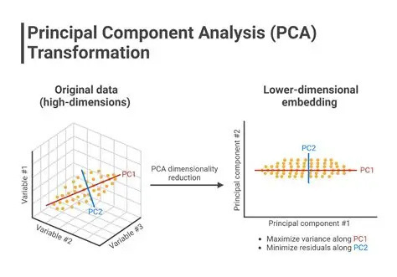
Ananda Rimal
PCA
August 3, 2026
2/21

Slide 3
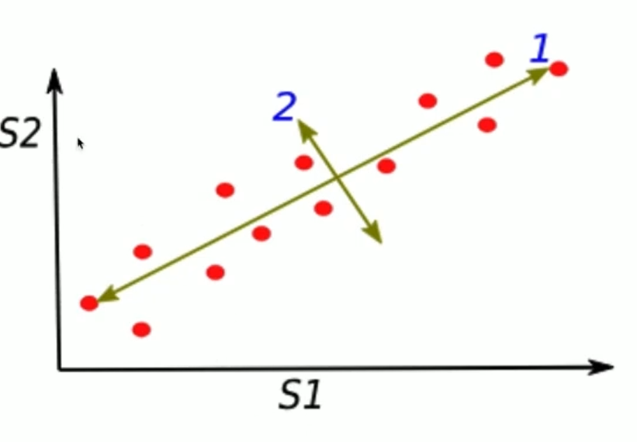

Slide 4

Ananda Rimal
PCA
August 3, 2026
3/21

Slide 5

Ananda Rimal
PCA
August 3, 2026
4/21

Slide 6
Outline
Real-World Products Using PCA
Visual Understanding of PCA
Why Do We Need PCA?
Simple 2D Example: Student Scores
PCA Step-by-Step Mathematics (Direct from Covariance) Complete PCA Algorithm
Another Example: Solving Cv = λv
1
2
3
4
5
6
7
Ananda Rimal
PCA
August 3, 2026
5/21

Slide 7

More PCA-Powered Products
▶ ▶ ▶ ▶
Credit Scoring (FICO) Adobe Photoshop MATLAB / Scikit-learn Weather Forecasting
▶ ▶ ▶ ▶
Bloomberg Terminal MRI / CT Scanners Cybersecurity Tools Google Images
Common Pattern
All deal with high-dimensional data needing compression or visualization!
Ananda Rimal
PCA
August 3, 2026
6/21

Slide 8
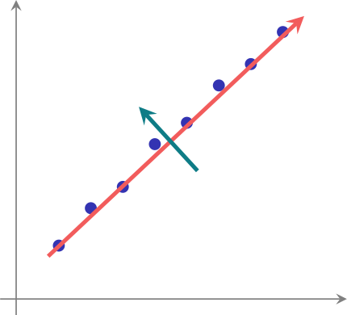
Visual Intuition: What Does PCA Do?
Original 2D Data
After PCA: 1D Projection
X
2
PC1
PC1
all points now live on ONE axis
PC2
X
1
PCA finds the direction (PC1) that captures maximum variance!
Ananda Rimal
PCA
August 3, 2026
7/21

Slide 9
Real Problems PCA Solves
Before PCA:
After PCA:
▶ ▶ ▶ ▶ ▶ ▶
Can’t visualize 100D data ML models train slowly Redundant information Noise degrades performance Storage costs high Overfitting risk
▶ ▶ ▶ ▶ ▶ ▶
Plot in 2D/3D easily Training 10x faster
Retain 95%+ information Noise automatically removed 90% compression
Better generalization
Ananda Rimal
PCA
August 3, 2026
8/21

Slide 10
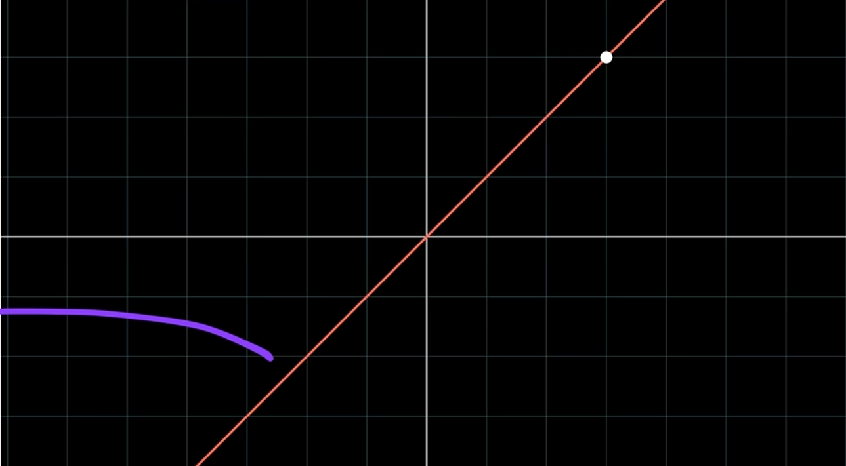

Slide 11
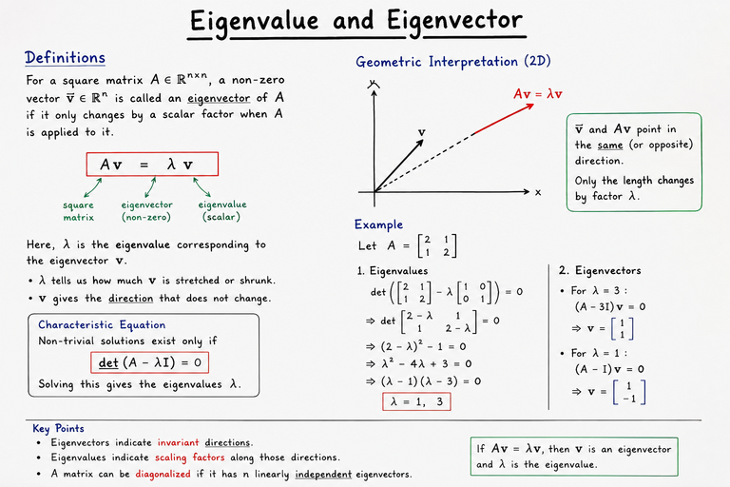

Slide 12
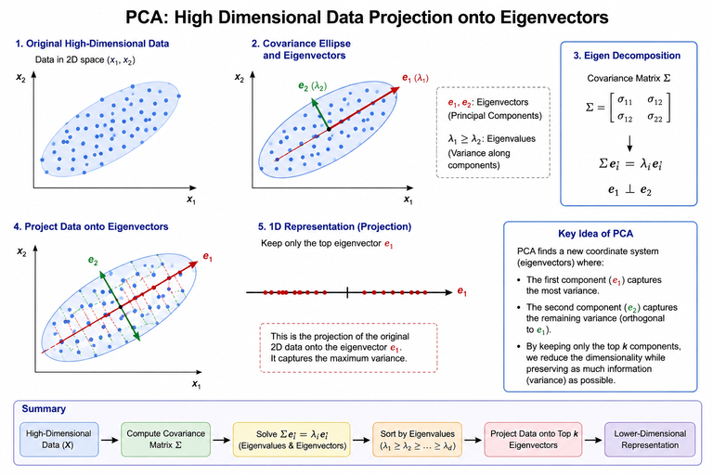

Slide 13
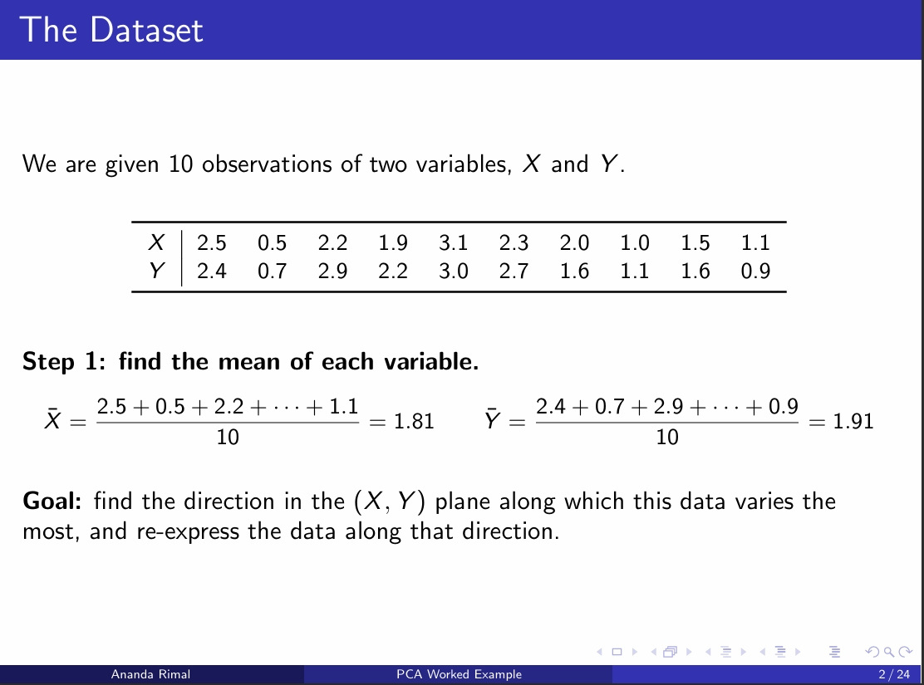

Slide 14
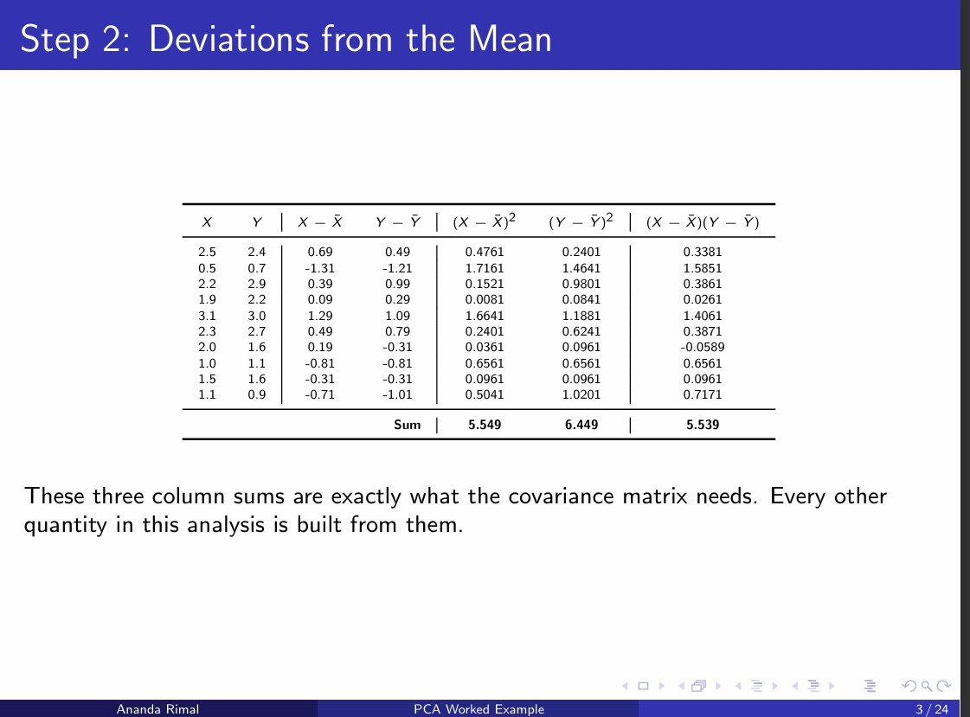

Slide 15
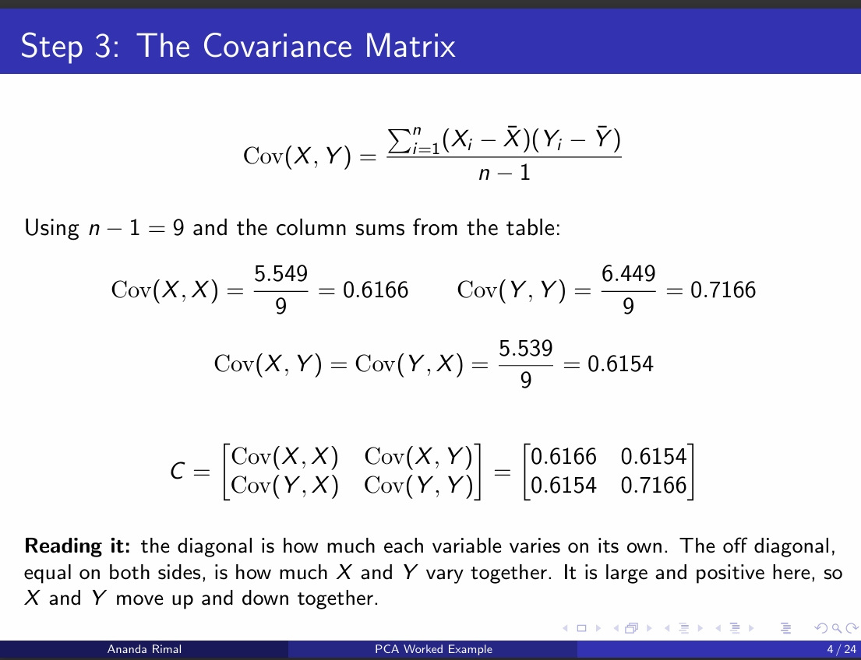

Slide 16
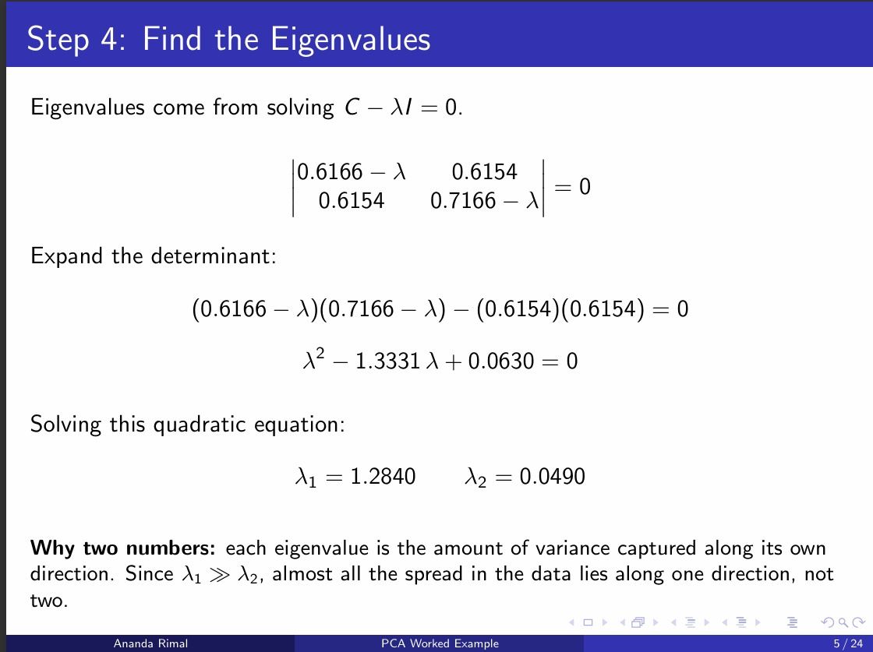

Slide 17
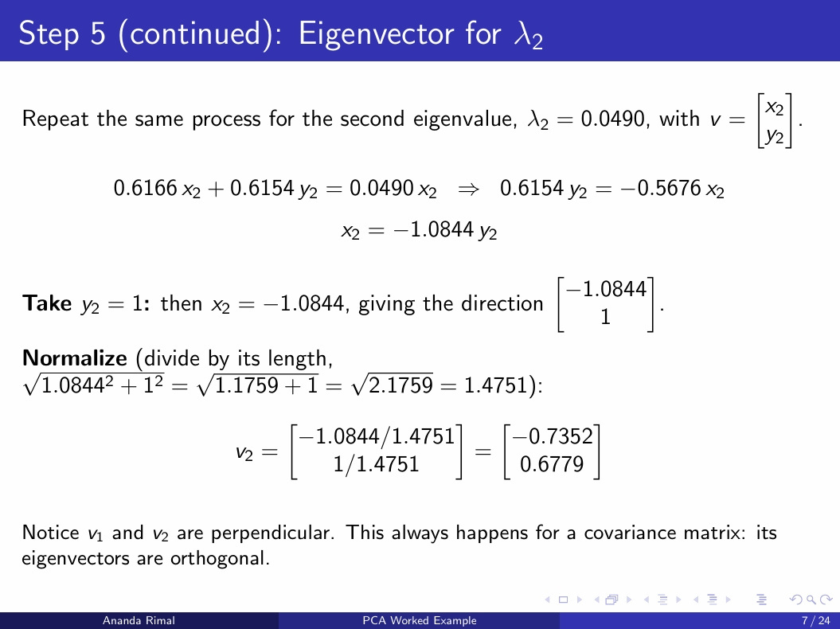

Slide 18
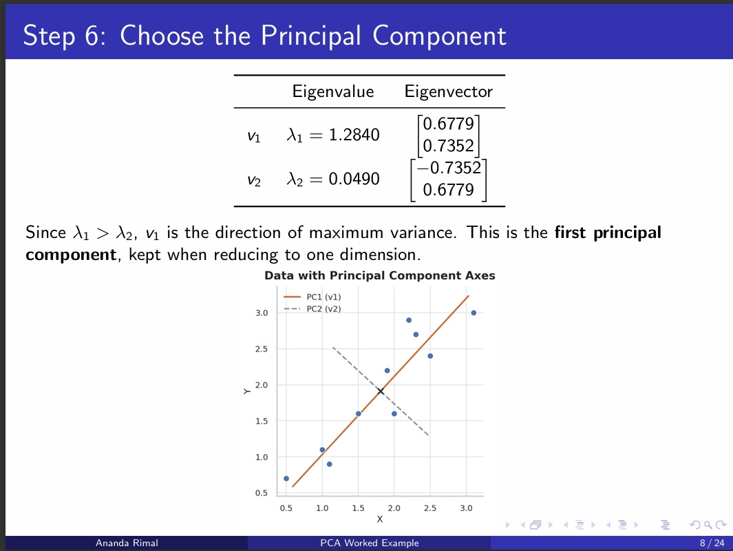

Slide 19
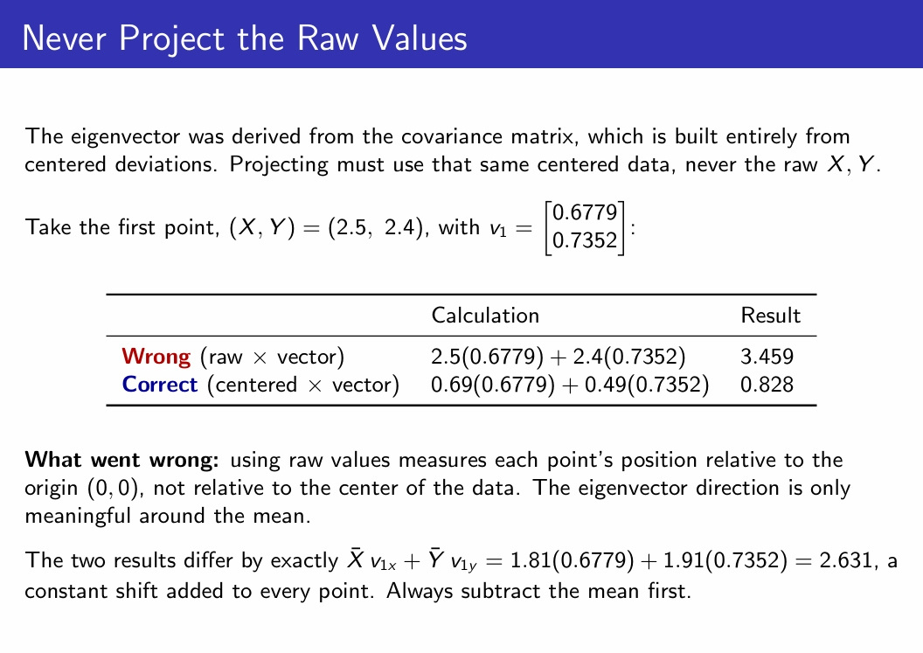

Slide 20
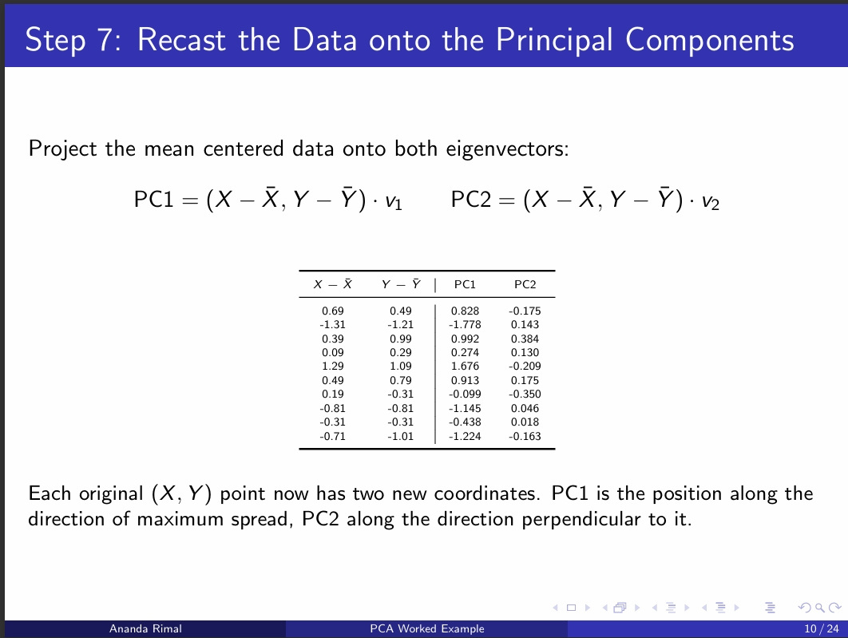

Slide 21
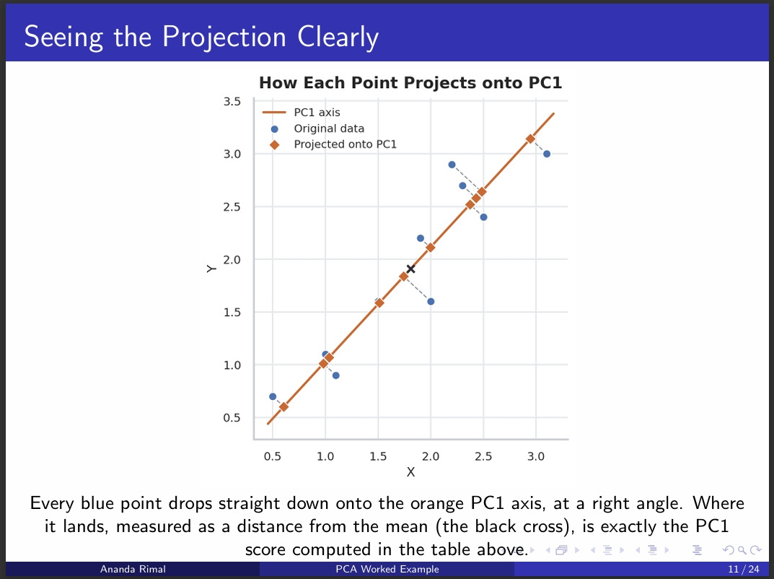

Slide 22
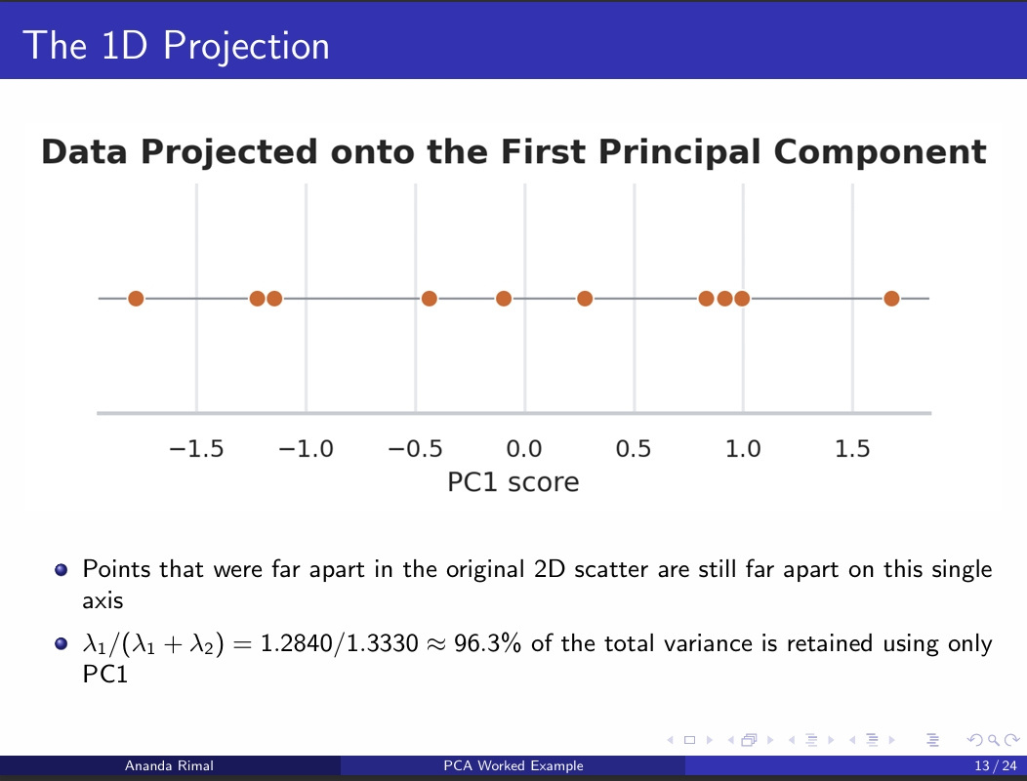

Slide 23
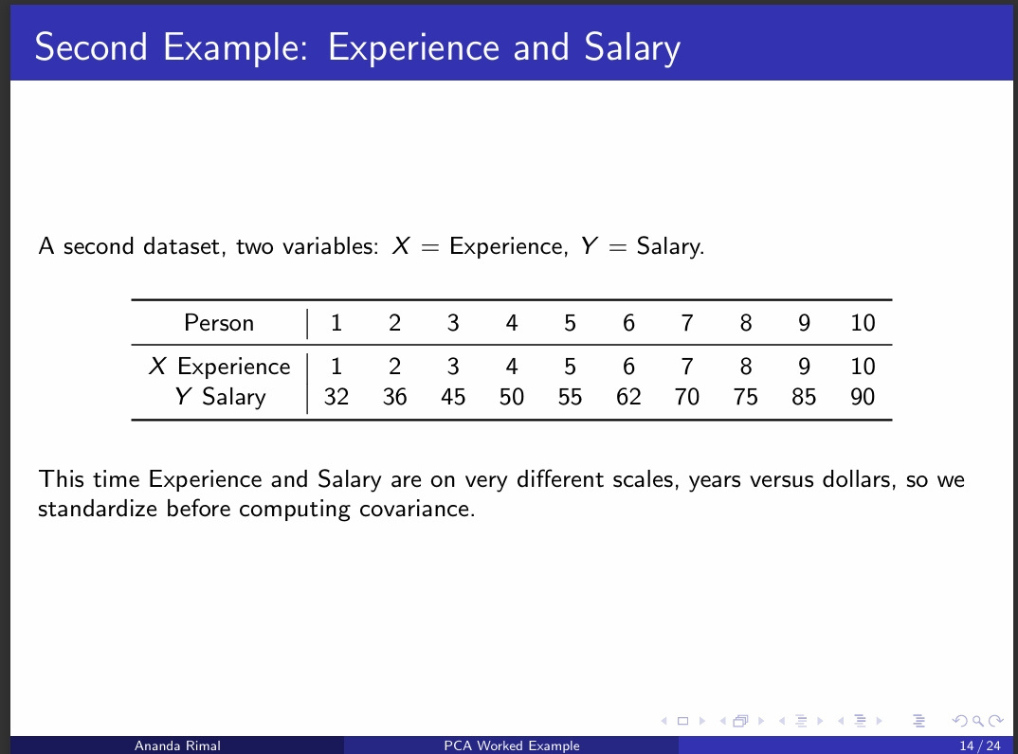

Slide 24
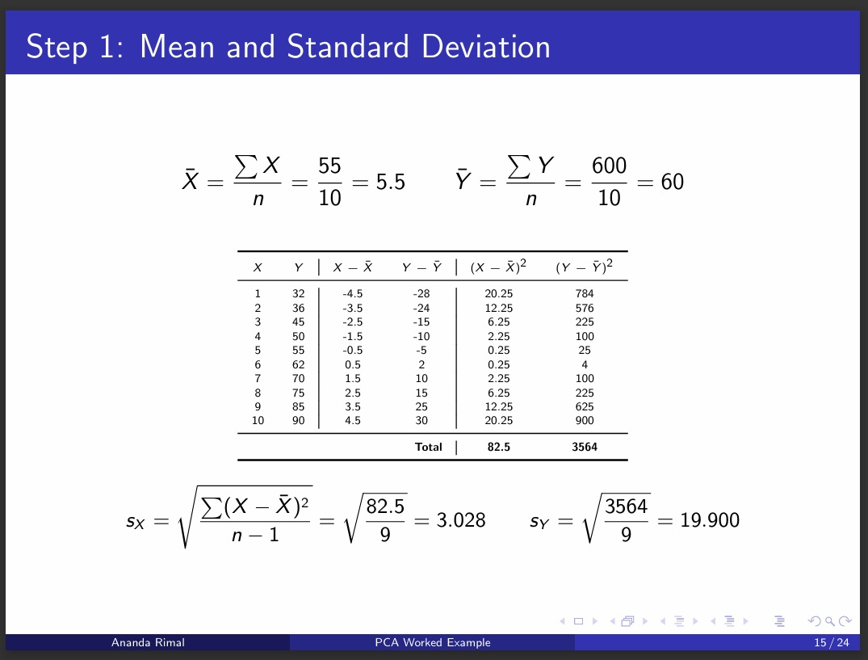

Slide 25
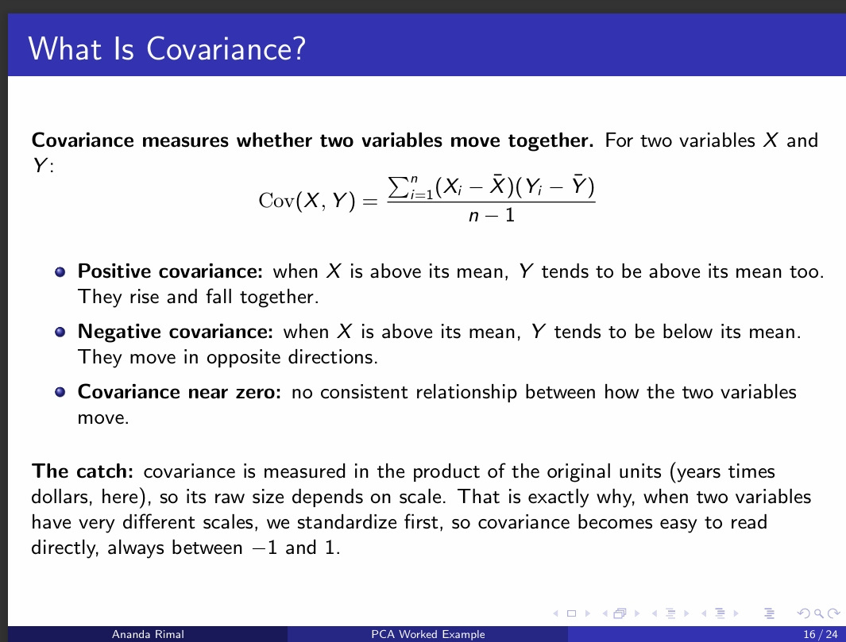

Slide 26
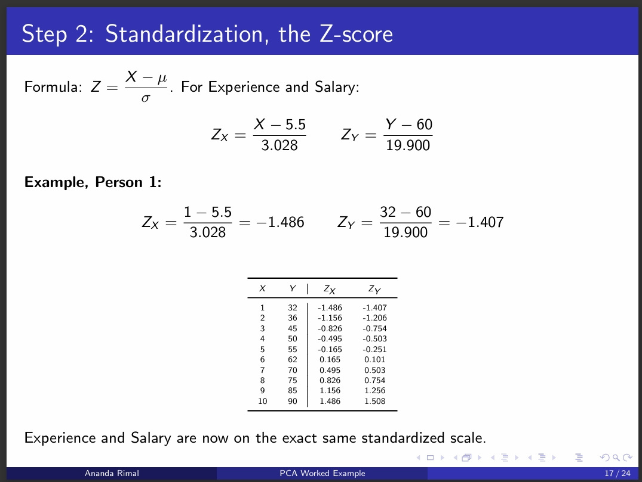

Slide 27
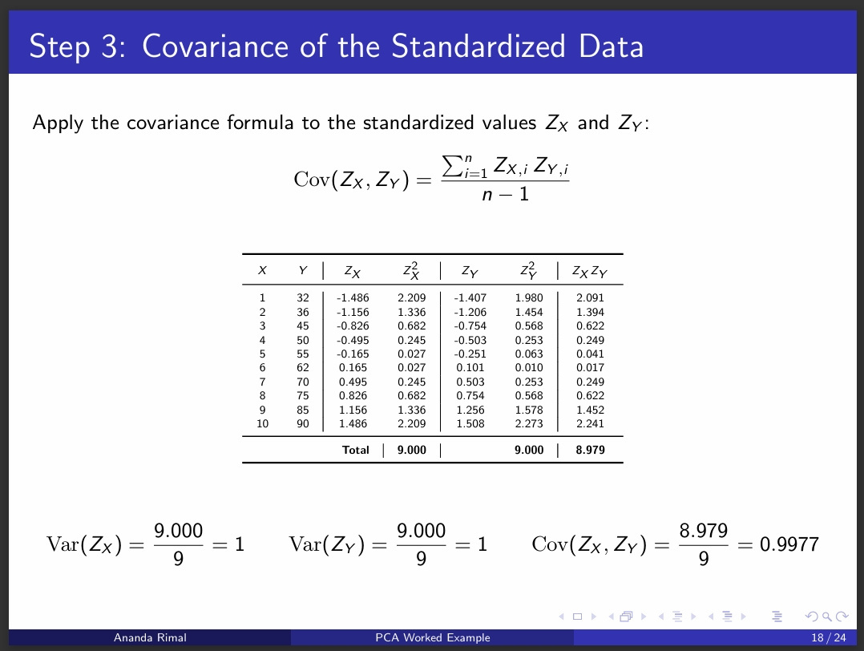

Slide 28
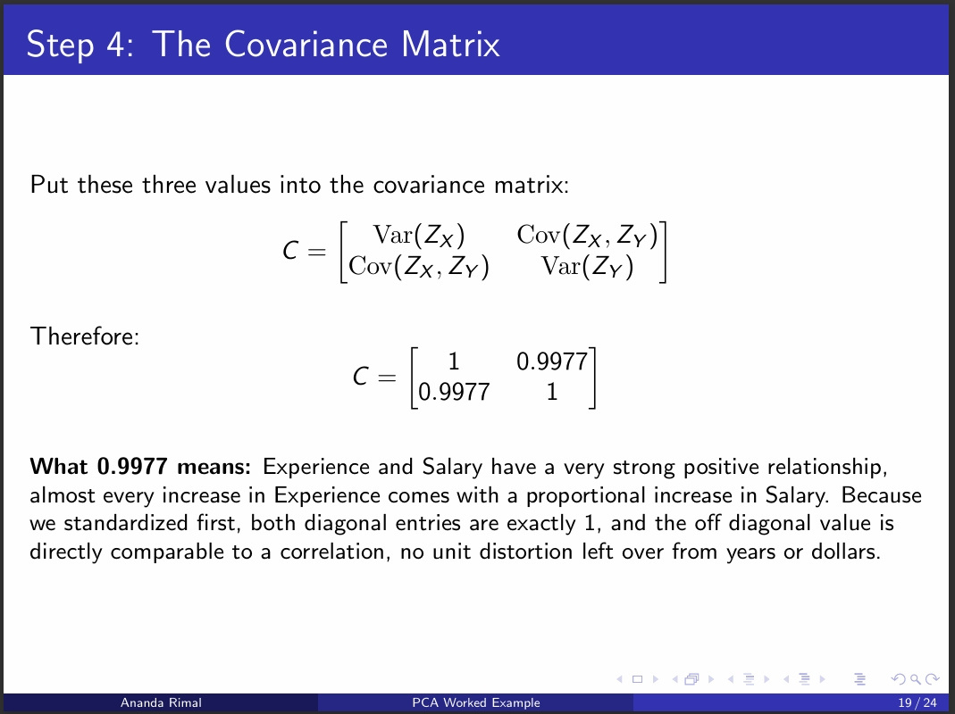

Slide 29
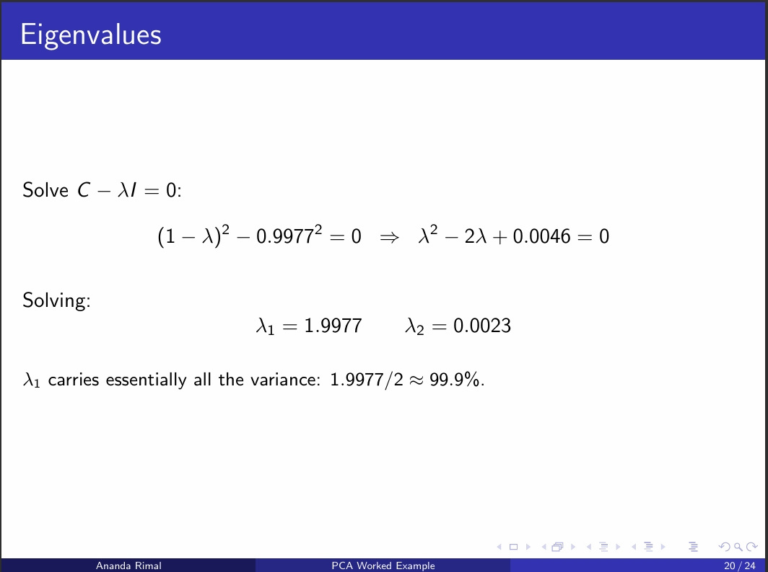

Slide 30
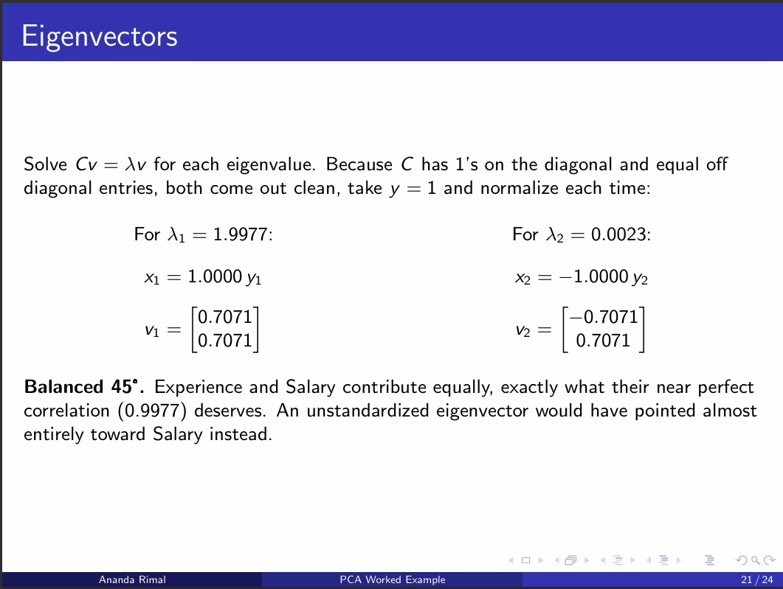

Slide 31
